Slide 1


Slide 2
HALF ADDER AND FULL ADDER CIRCUIT
CIT,2- Year ELT-II

Slide 3
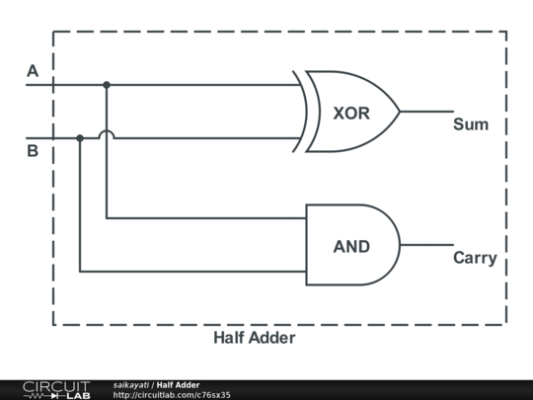
Half Adder
half adder is a digital logic circuit that adds two single-bit binary numbers, producing a "Sum" bit and a "Carry" bit. It consists of an XOR gate for the sum and an AND gate for the carry. This circuit is limited to adding only two bits and cannot handle a carry input from a previous stage.
CIT,2- Year ELT-II

Slide 4
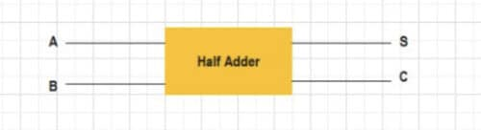
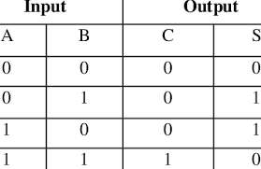
CIT,2- Year ELT-II

Slide 5
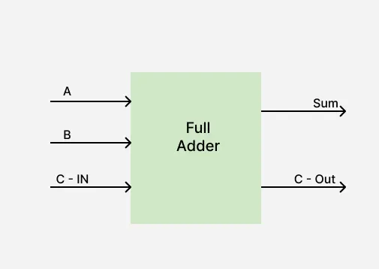
Full Adder
Full Adder is a combinational circuit that adds three inputs and produces two outputs. The first two inputs are A and B and the third input is an input carry as C-IN. The output carry is designated as C-OUT and the normal output is designated as S which is SUM.
CIT,2- Year ELT-II

Slide 6
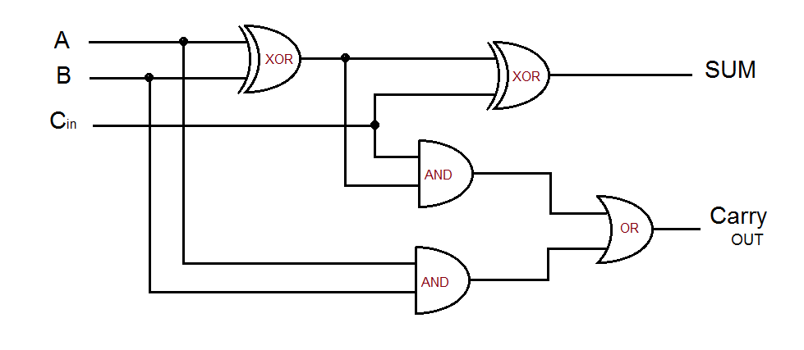

Slide 7
INPUT |  |  | OUTPUT
A | B | C-IN | Sum | C-OUT
0 | 0 | 0 | 0 | 0
0 | 0 | 1 | 1 | 0
0 | 1 | 0 | 1 | 0
0 | 1 | 1 | 0 | 1
1 | 0 | 0 | 1 | 0
1 | 0 | 1 | 0 | 1
1 | 1 | 0 | 0 | 1
1 | 1 | 1 | 1 | 1
CIT,2- Year ELT-II

Slide 8
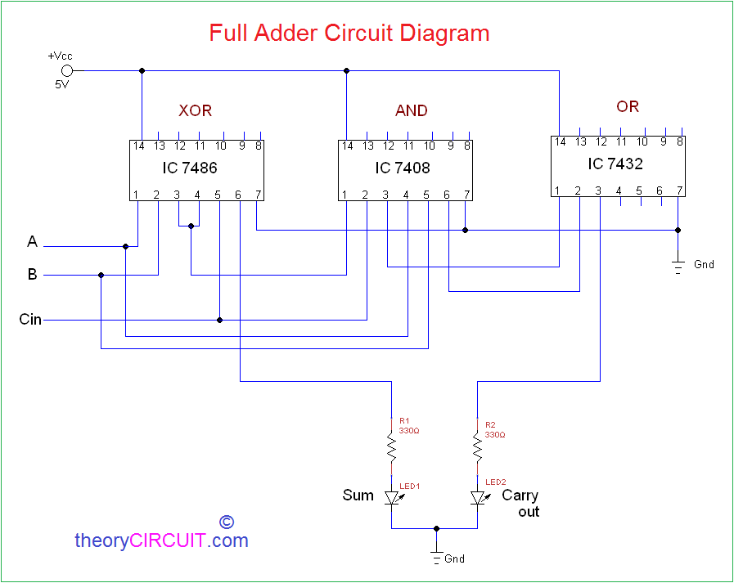
CIT,2- Year ELT-II

